Slide 1
WRC-23 Agenda Item 1.2 – 6 GHz band 3rd EACO WRC-23 Preparatory Meeting 17 – 19 August 2021
CONFIDENTIAL: This document is intended for the use of recipients only and may not be distributed externally or reproduced for external distribution in any form without express written permission of Policy Impact Partners.

Slide 2
Agenda Item 1.2
The 6 GHz band and WRC-23 Agenda Item 1.2
WRC-23 agenda item 1.2 considers, amongst others, possible IMT identification for 6425 - 7025 MHz (for Region 1) and 7025 - 7125 MHz globally (upper 6 GHz band), should studies support coexistence with incumbent primary services
Agenda
KEY TO GROWTH AND DEVELOPMENT
Incumbents in the upper 6 GHz band
Wi-Fi in the 6 GHz band
Conclusions

Slide 3
Incumbents in the upper 6 GHz band
Allocation and use of the 6 GHz band in Africa
Allocation to services
Region 1 | Region 2 | Region 3
5 925-6 700 FIXED 5.457 FIXED-SATELLITE (Earth-to-space) 5.457A 5.457B MOBILE 5.457C 5.149 5.440 5.458
6 700-7 075 FIXED FIXED-SATELLITE (Earth-to-space) (space-to-Earth) 5.441 MOBILE 5.458 5.458A 5.458B
7 075-7 145 FIXED MOBILE 5.458 5.459
KEY TO GROWTH AND DEVELOPMENT
Use | Frequency range
Fixed links in the Fixed Service (FS) | 6 425-7 125 MHz
Fixed Satellite Service (FSS) uplink (VSAT/SNG) | 6 425-6 725 MHz
Appendix 30B uplinks (FSS) | 6 725-7 025 MHz
Radio Astronomy | 6 650-6 675.2 MHz

Slide 4
The upper 6 GHz band
Incumbents in the upper 6 GHz band
Studies in the 6 GHz band
ITU-R WP5D is responsible for WRC-23 Agenda Item 1.2 and will conduct studies to determine whether IMT can share this spectrum with incumbent services
The results of ECC studies for the lower 6 GHz band (5925-6425 MHz) show that Low Power Indoor (LPI) and Very Low Power (VLP) indoor/outdoor licence–exempt WAS/RLAN can coexist with incumbents
In addition to work ongoing in WP5D, African administrations should also conduct studies to see if licence-exempt technologies can coexist with existing incumbent services in the upper 6 GHz band
This means Administrations will have all the facts in hand before WRC-23 and help them decide if WAS/RLAN and/or IMT are viable options for sharing with incumbent services in this band.
KEY TO GROWTH AND DEVELOPMENT

Slide 5
The upper 6 GHz band
Incumbents in the upper 6 GHz band
The need to respect Appendix 30B
In ITU Region 1, the 6725-7025 MHz band is subject to Appendix 30B of the ITU Radio Regulations
This appendix is intended to guarantee, for all countries, equitable access to the geostationary-satellite orbit in the 6725-7025 MHz band.
Therefore, Africa’s Administrations have rights to operate this band over their territory without time limits.
Any deployment of wireless technologies in the 6725-7025 MHz band will need to protect the Appendix 30B national allotments of all African countries.

Slide 6
The upper 6 GHz band
Incumbents in the upper 6 GHz band
Key considerations in the upper 6 GHz band
The Radio Astronomy service, including the Square Kilometre Array (SKA) radio telescope in South Africa and some other African countries, will need to be protected if the band is identified for IMT
At a recent international spectrum conference*, UK regulator Ofcom noted that in the upper 6 GHz band “…coexistence between existing users and high power outdoor mobile is not possible – would require clearing incumbents.”
Relocation of incumbents, especially fixed services, would be difficult and contentious. There is no clear view as to where these incumbents would go.
Administrations should maintain the flexibility to enable licence-exempt technologies, to use the upper 6 GHz band, subject to the outcome of sharing and compatibility studies.
KEY TO GROWTH AND DEVELOPMENT

Slide 7
Wi-Fi in the 6 GHz band
Alternative ways to harness the 6 GHz band
The 6 GHz band is not well-suited for bringing IMT connectivity to rural areas of Africa, many of which remain unconnected, as it has unfavourable propagation characteristics
This band can be better used by licence-exempt WAS/RLANs as a cost-effective way to distribute the broadband connectivity from IMT and satellite systems
The fixed links in the upper 6 GHz band have similar characteristics to those in the lower 6 GHz band where WAS/RLAN is being deployed and the same regulatory conditions, relating to indoor and outdoor usage and power levels, can be applied for licence-exempt WAS/RLAN across the entire 6 GHz band

Slide 8
Wi-Fi in the 6 GHz band
Global momentum to open the 6 GHz band to Wi-Fi
The FCC in the US is allowing low power indoor Wi-Fi across the entire 6 GHz band. It noted that Wi-Fi and other unlicensed technologies “have become indispensable for providing low-cost connectivity in countless products”.
Brazil, Canada, Chile, Saudi Arabia, South Korea & some other countries are also making the entire 1200 MHz in the 6 GHz band available for licence-exempt Wi-Fi use
As a result, a viable ecosystem supporting WI-FI in the 6 GHz band already exists
KEY TO GROWTH AND DEVELOPMENT

Slide 9
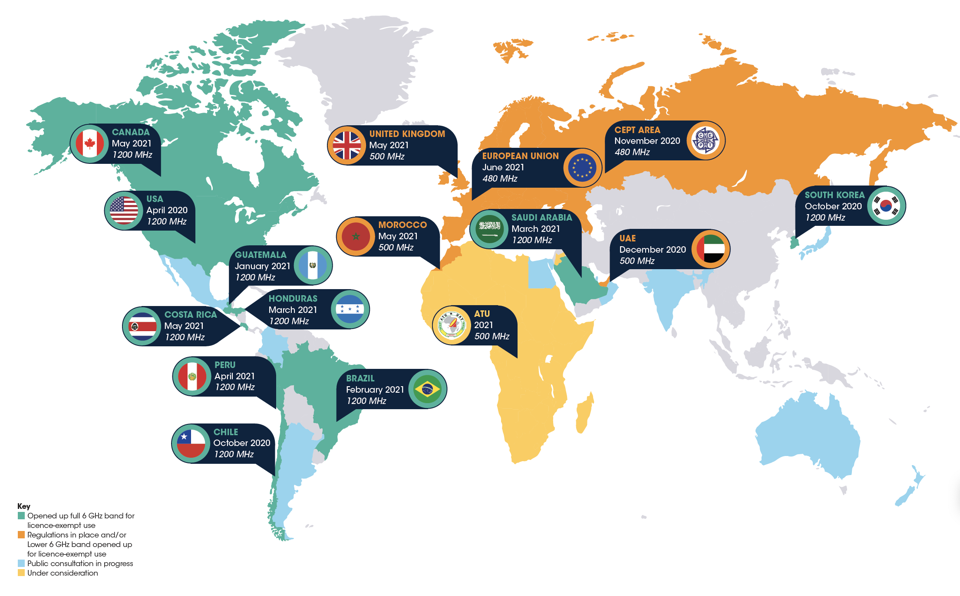
Wi-Fi in the 6 GHz band
Wi-Fi in the 6 GHz band – the global picture

Slide 10
Wi-Fi in the 6 GHz band
Wi-Fi 6 and 4G/5G are complementary
Without the ability to offload traffic to Wi-Fi, 4G/5G would be less affordable: mobile operators would need to invest more in their networks, deploying many more small cells in dense urban areas.
Wi-Fi 6 can support 4G/5G use cases, such as HD video streaming, Wi-Fi calling, smart home devices, hotspot access, automation of city-wide services, AR/VR applications, health monitoring devices, wearables and seamless roaming.
KEY TO GROWTH AND DEVELOPMENT

Slide 11
Wi-Fi in the 6 GHz band
The ATU moves to harness the 6 GHz band
The African Telecommunications Union (ATU) has approved the recommendation by its Emerging Technologies Task Group to enable licence-exempt 5G NR-U and WAS/RLANs to operate in the lower 6 GHz (5925-6425 MHz) band. WAS/RLANs can operate at low power indoors and very low power indoors and outdoors
Adoption of the Recommendation by each African country will be a crucial step in addressing the licence-exempt spectrum shortfall and bringing major socio-economic benefits to each country.

Slide 12
Conclusions
Summary and recommendations
The upper part of the 6 GHz band (6425-7125 MHz) is being considered for IMT identification under WRC-23 Agenda Item 1.2
Existing services, including the Radio Astronomy service and Appendix 30B allocations of African countries, need to be protected.
A viable ecosystem supporting Wi-Fi across the 6 GHz band already exists, paving the way for Africa to use Wi-Fi 6E to improve connectivity
In addition to work ongoing in WP5D, African administrations should also conduct studies to see if licence-exempt technologies can coexist with existing incumbent services in the upper 6 GHz band

